Slide 1
Isha R
Reg No: 2021506028
Final Project
3/21/2024 Annual Review

Slide 2
PROJECT TITLE
Image Generation and Captioning for Social Media
This project aims to develop an automated image generation and captioning system for Instagram images using deep learning techniques to streamline the captioning process and enhance engagement. The system targets individual users, businesses, and content creators seeking to improve their social media presence and audience interaction.
3/21/2024 Annual Review

Slide 3

AGENDA
Setup: Importing necessary libraries and modules.
Configuration: Explanation of configuration parameters.
Model Initialization: Initializing the Stable Diffusion model.
Image Generation Function: Overview of the function for generating images from text prompts.
Execution: Example execution with a sample prompt.
Image Feature Extraction: Utilize a pre-trained VGG16 model to extract features from Instagram images.
Text Preprocessing: Clean and preprocess the captions associated with the images to prepare them for modeling.
Model Development: Develop a neural network model that combines image features with captions to generate descriptive captions for the images.
Training and Validation: Train the model on a dataset of images and their corresponding captions, and validate its performance using a separate validation dataset.
Evaluation: Evaluate the model's performance using metrics such as BLEU score to assess the quality of generated captions.
Deployment: Once the model is trained and evaluated, deploy it as a tool or service that can automatically generate captions for new Instagram images.
Optimization and Fine-tuning: Continuously optimize and fine-tune the model to improve the quality and diversity of generated captions over time.
3/21/2024 Annual Review

Slide 4
PROBLEM STATEMENT
In the era of social media dominance, individuals and businesses frequently share images on platforms like Instagram to engage their audience. However, crafting engaging and descriptive captions for these images can be time-consuming and challenging. The problem we aim to address is the manual effort required to generate captions for Instagram images. This process often leads to inconsistent or uninspiring captions that fail to captivate the audience.
My objective is to develop a text-to-image generation system utilizing Stable Diffusion and Transformers and an automated captioning system that can generate descriptive and engaging captions for Instagram images. By leveraging deep learning techniques, we aim to create a solution that streamlines the captioning process, saving time and effort for users while enhancing the overall quality of captions.
3/21/2024 Annual Review

Slide 5
PROJECT OVERVIEW
To develop an automated captioning system for Instagram images to streamline the captioning process and enhance engagement. Utilizing deep learning techniques, the system aims to generate descriptive and engaging captions automatically.
Problem Statement: Crafting engaging captions for Instagram images is time-consuming and leads to inconsistent results.
Objective: Develop an automated captioning system using deep learning to save time and improve caption quality.
Proposed Solution: Create a deep learning model trained on image-caption pairs to automatically generate engaging captions for Instagram images.
3/21/2024 Annual Review

Slide 6

WHO ARE THE END USERS?
The end users of the automated captioning system for Instagram images include:
Individual Users: Social media enthusiasts, influencers, and everyday users looking to enhance their Instagram posts with engaging captions.
Businesses and Brands: Marketing teams, businesses, and brands aiming to improve their social media presence and audience engagement on Instagram.
Content Creators: Bloggers, photographers, artists, and creators seeking to streamline their content creation process and increase audience interaction on Instagram.
3/21/2024 Annual Review

Slide 7
YOUR SOLUTION AND ITS VALUE PROPOSITION
My solution involves creating a deep learning model trained on image-caption pairs to automatically generate engaging captions for Instagram images.
By leveraging this technology, users can save time and effort in crafting captions while enhancing the quality and consistency of their social media posts.
This value proposition addresses the challenge of manual captioning, offering a streamlined solution that improves social media presence and audience engagement for individuals, businesses, and content creators.
3/21/2024 Annual Review

Slide 8
THE WOW IN YOUR SOLUTION
The wow factor in my solution lies in its ability to seamlessly integrate deep learning techniques to understand image content and generate descriptive captions automatically.
By harnessing the power of AI, users can effortlessly enhance their Instagram posts with engaging captions, saving time and elevating their social media presence with captivating content.
3/21/2024 Annual Review

Slide 9
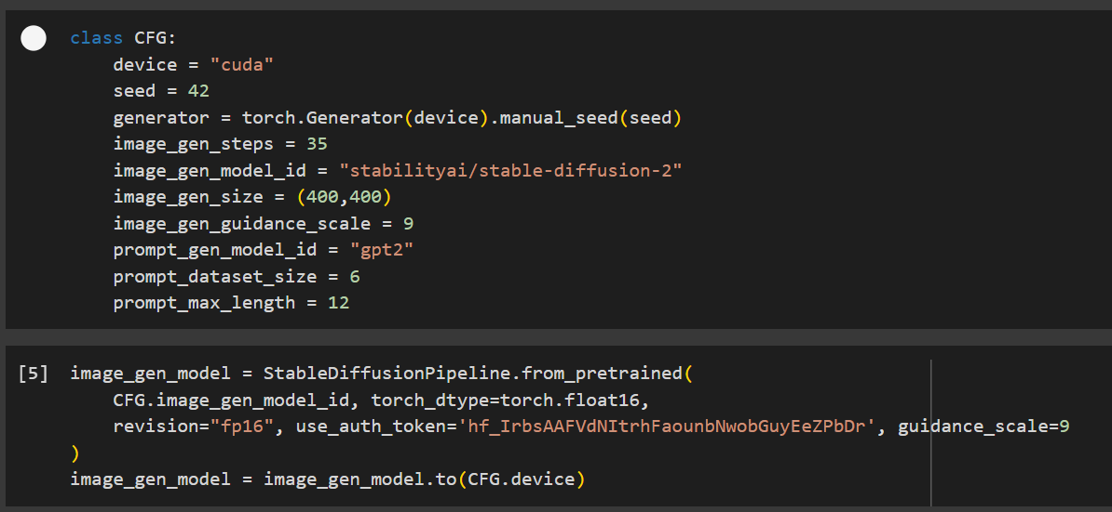
MODELLING
3/21/2024 Annual Review

Slide 10
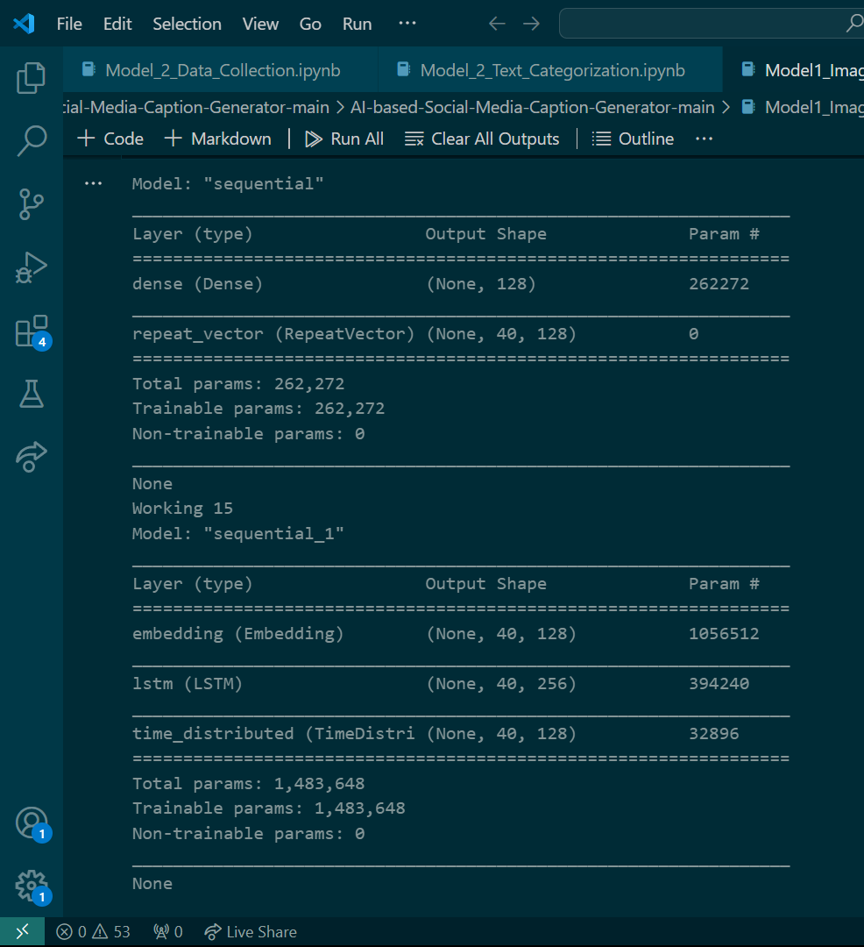
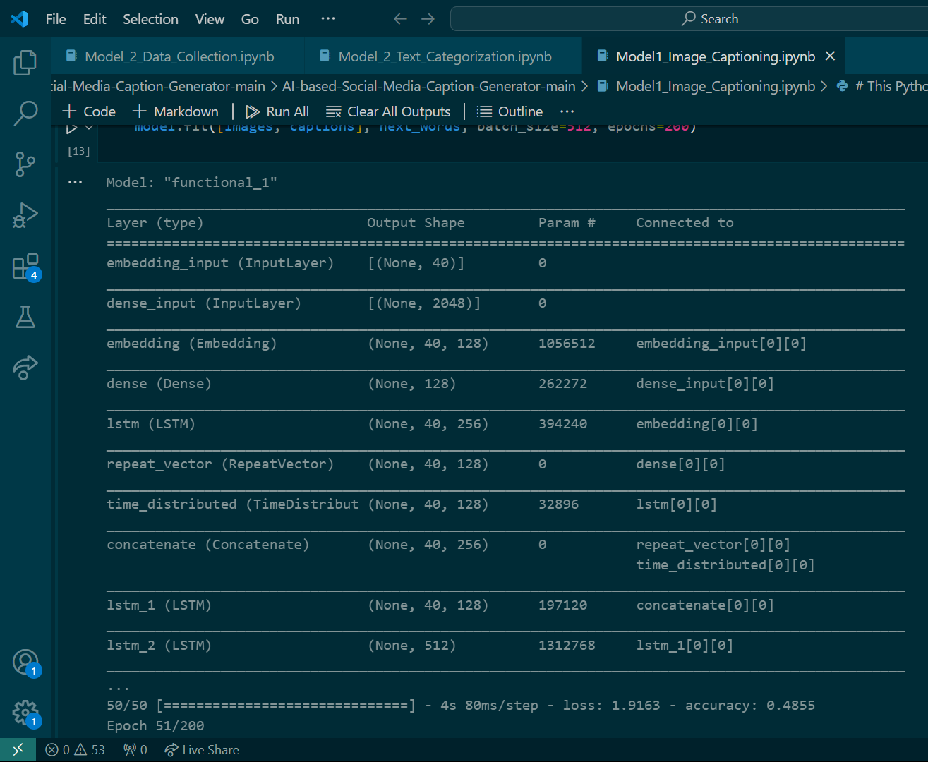
MODELLING
Teams cam add wireframes
3/21/2024 Annual Review

Slide 11
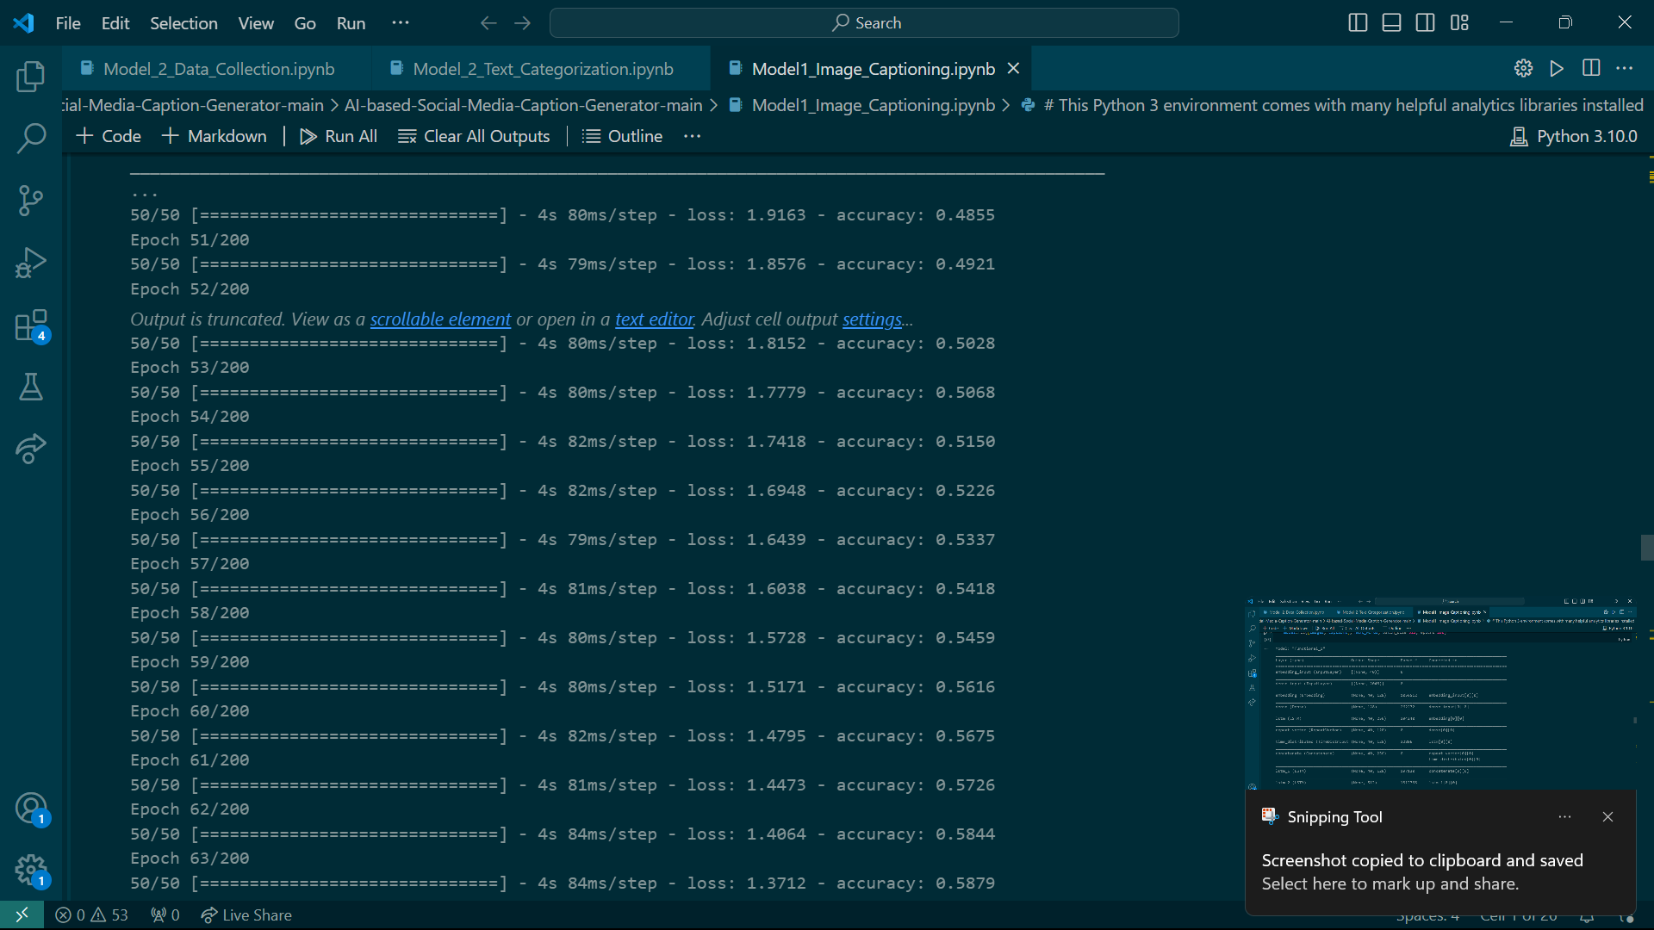
MODELLING
3/21/2024 Annual Review

Slide 12
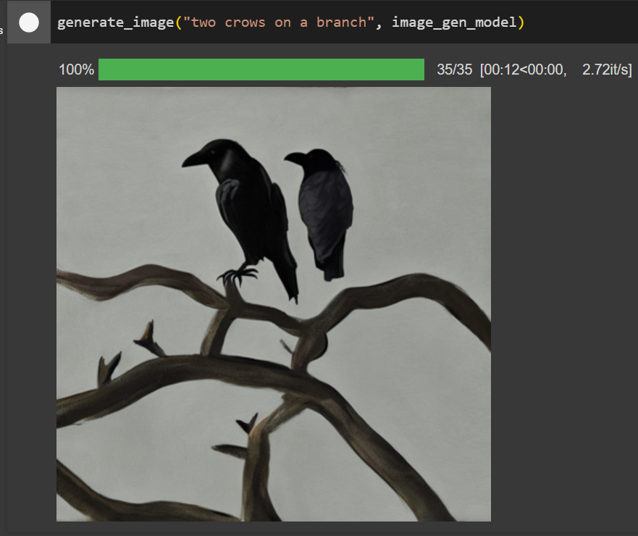
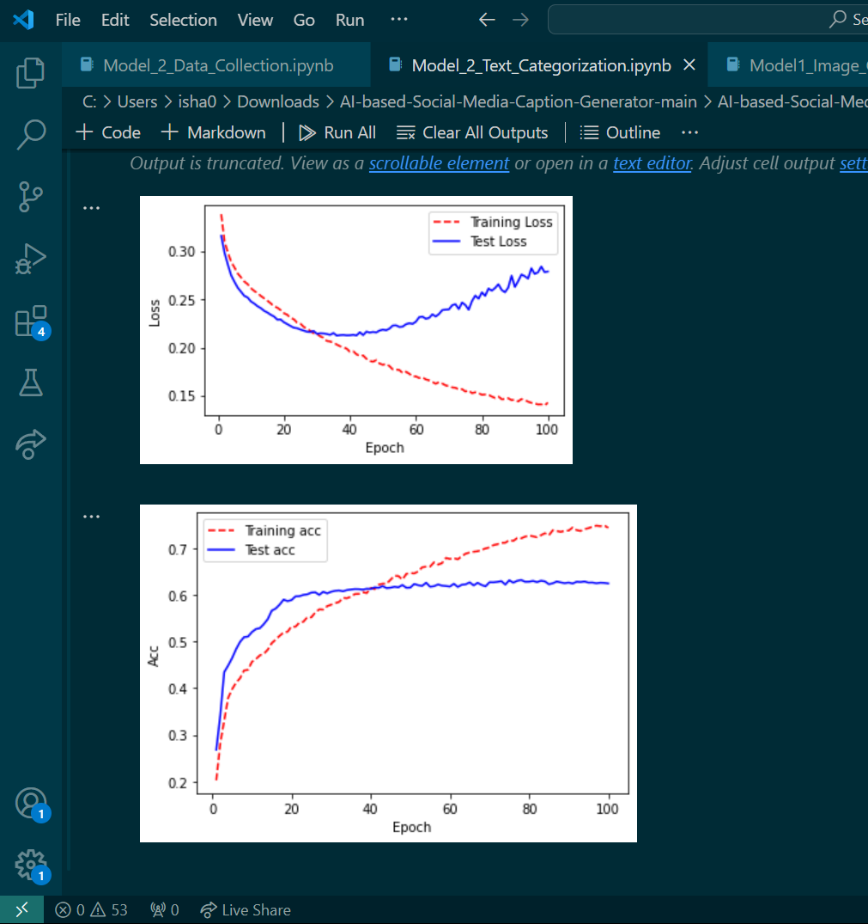
RESULTS
PROJECT DEMO LINK 1
PROJECT DEMO LINK 2
3/21/2024 Annual Review

